Slide 1
Defoliation assessment in Eucalyptus globulus plantations through the use of multispectral cameras mounted on a UAV (Unmanned Aerial Vehicle)
Prendes C., Soares P., Branco M., Majada J., Diez J., Lario F., González-García M., Canga E.
(September 17– 21, 2018, Montpellier , France)
Covadonga Prendes Pérez
CETEMAS. Centro Tecnológico y Forestal de la Madera de Asturias

Slide 2
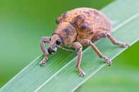
INTRODUCTION
(
What is PLURIFOR project?
OBJECTIVE
The aim of PLURIFOR is to help with the development of regional and transnational risk management plans for forest areas susceptible to biotic and abiotic hazards.
The project comprises 11 partners and 21 associate partners, uniting research institutes, universities, forest related organisations and regional governments and councils from the Interreg Sudoe countries of Portugal, Spain and France
Fire Risk
Development of a new tool to assess the defoliation caused by Gonipterus platensis through the use of multispectral cameras mounted on a UAV
Soil degradation
Eucalyptus pests
Notes:
Esta especie está considerada la principal plaga de los eucaliptos en la Península Ibérica. De acuerdo con el último inventario de daños forestales (IDF) en España (Red europea de Seguimiento de Daños en los Bosques -Nivel I), en 2017 se ha observado una defoliación del 29% con niveles moderados o muy severos, que se traducen en una inhibición del crecimiento cada año de entre 800.000 y 1.200.000 toneladas de madera de Eucalyptus globulus (el 20-25% del crecimiento corriente anual del eucalipto estimado por el 4 IFN en 5.350.000 Tn/año).
En este contexto, la presencia de G. platensis, ocasiona graves pérdidas económicas, sociales y ambientales en el entorno rural ligado a la explotación del eucalipto, lo que afecta a la práctica totalidad de los eucaliptales septentrionales de España.

Slide 3
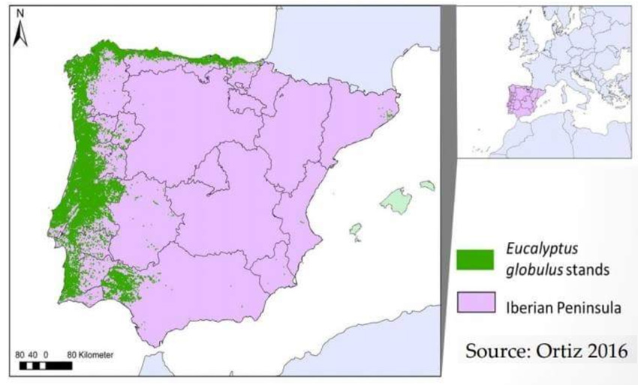
INTRODUCTION
(
Gonipterus platensis. Some data…
Eucalyptus globulus is the main species used for pulp production
Spain and Portugal supply 40% of the pulp demanded by the European Union
Gonipterus platensis is the most harmful pest affecting Eucalyptus stands in the Iberian Peninsula
Around 1,8 M m³ of wood are lost each year in because of defoliation
Image analysis obtained through Unmanned Aerial Vehicles allows not only the identification of areas affected by weevil beattle but also distinguish between damage intensities.

Slide 4
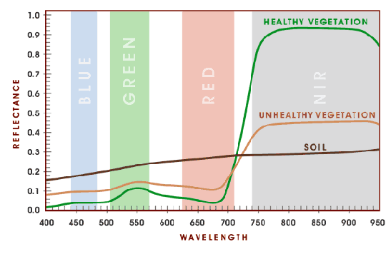
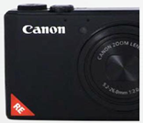
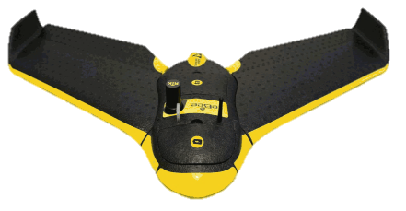
INTRODUCTION
(
Key concepts
Healthy vegetation has a characteristic spectral response. The ALTERATIONS in the SPECTRAL RESPONSE of the vegetation are reflected in the different bands of the electromagnetic spectrum (specially RED, NIR and RE)
SENSOR
UAV
Image analysis obtained through Unmanned Aerial Vehicles allows not only the identification of areas affected by weevil beattle but also distinguish between damage intensities.

Slide 5
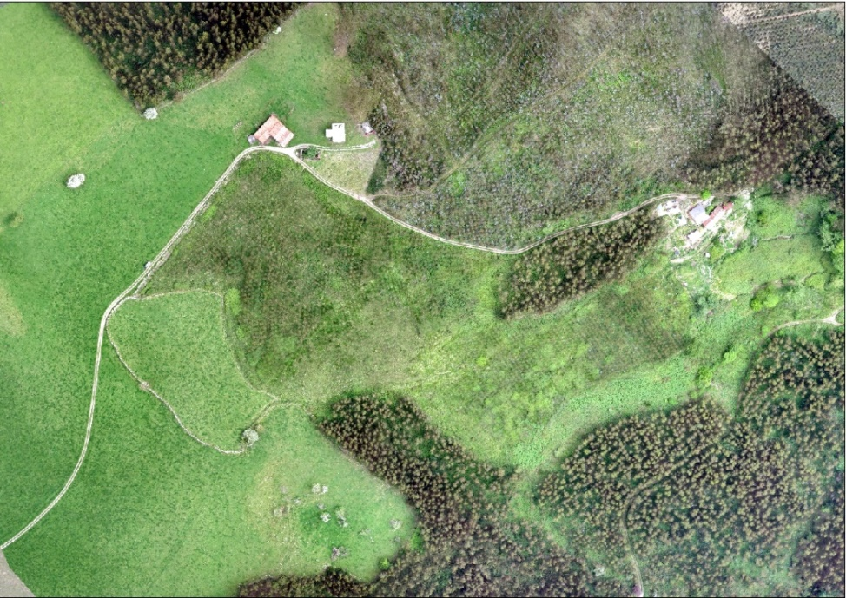
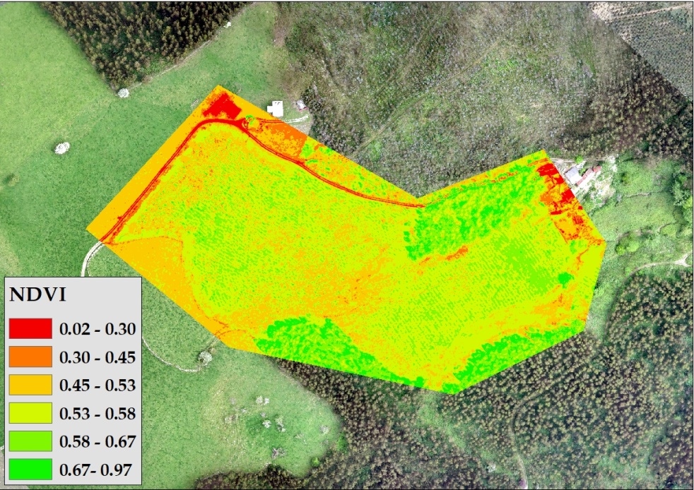
INTRODUCTION
(
Key concepts
Vegetation indexes
Combination of spectral bands that highlights a characteristic of vegetation within a pixel
They can be used to assess the vegetation health condition.
Field data are necessary for calibrating their values
ORTHOMOSAIC RGB
VEGETATION INDEX MAP
Image analysis obtained through Unmanned Aerial Vehicles allows not only the identification of areas affected by weevil beattle but also distinguish between damage intensities.
Notes:
Vegetation indexes is the most popular technique of remote sensing to predict agricultural crop biphysical variables such as leaf area index, clorophyll content/concentration, above ground biomass, percetn vegetation cover and so forth
Combination of spectral bands (added, divided, or multiplied) to produce a value that highlights a characteristic of vegetation within a pixel (degree of defoliation, chlorophyll content, vigor ...)
They allow to estimate and evaluate the state of health of the vegetation, based on the measurement of the radiation that the plants emit or reflect.
Field data are necessary for calibrating the obtained results

Slide 6
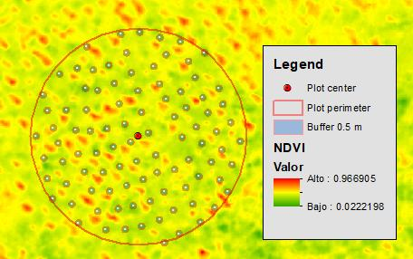
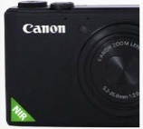
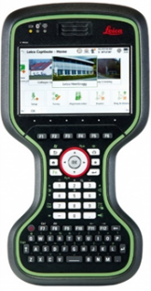
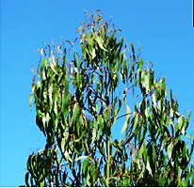
METHODOLOGY
(
WORKFLOW TO ASSES DEFOLIATION WITH VEGETATION INDEXES
1.Data acquisition
2. Image analysis
3.Field data + indexes maps
4. Statistical analysis
UAV+sensors
PC1
PC2
730 g
Árb | Def | NDVI | GCI
1 | 2 | 0.58 | 0.09
2 | 2 | 0.52 | 0.08
3 | 1 | 0.59 | 0.16
Field damage inventory

Slide 7
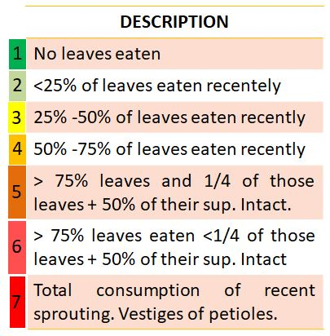
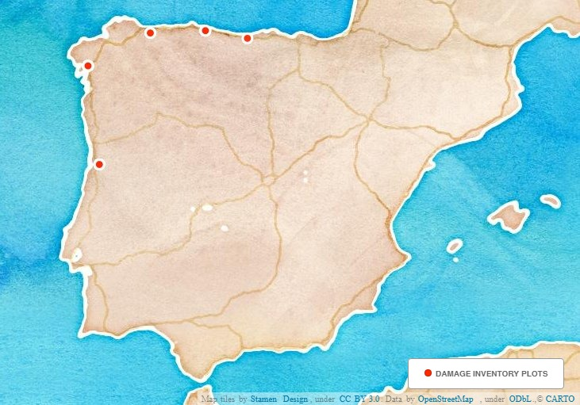
METHODOLOGY
(
1. Data acquisition: Field measurements
The areas to be selected had to meet the following requirements
Eucalyptus globulus plantations (4-6 years old)
Continous stands (at least 5 ha)
Different degree of attack
Differences in orography
Height and diameters
Phenology
Defoliation measurements
Notes:
There were 5 sample sites in this research
The areas to be selected had to meet the following requirements
Eucaliptus globulus young stands coming from PLANTATIONS (4-6 years old)
Continous stands, at least 5 ha
To install the plots in two areas with different degree of attack (Strong and weak)
Differences in orography to install the plots along the study area (high, low and middle slope)

Slide 8
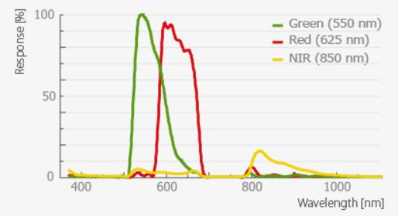
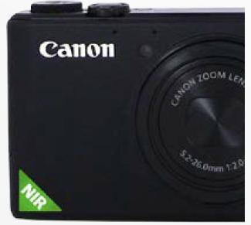
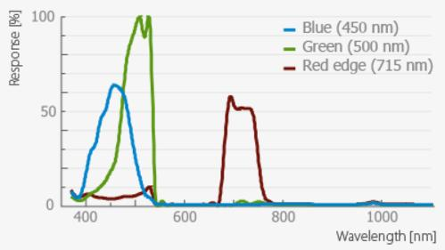
METHODOLOGY
(
1. Data acquisition with a UAV
Canon S110 NIR
UAV eBee RTK
96 cm
More than 30 flights in total over the 4 different areas coinciding with Gonipterus platensis strongest attacks
Canon S110 RE
730 g
Sequoia
Example of a flight plan with S110NIR camera

Slide 9
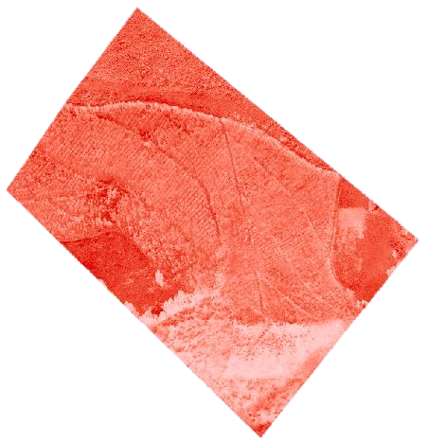
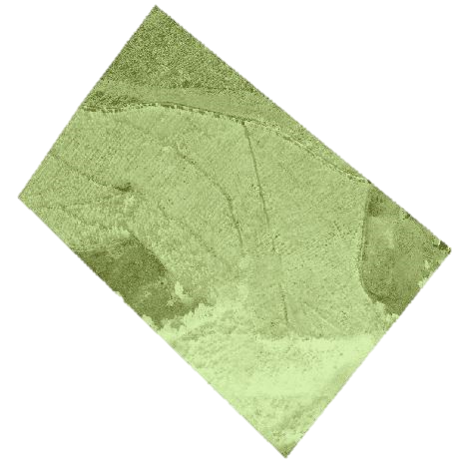
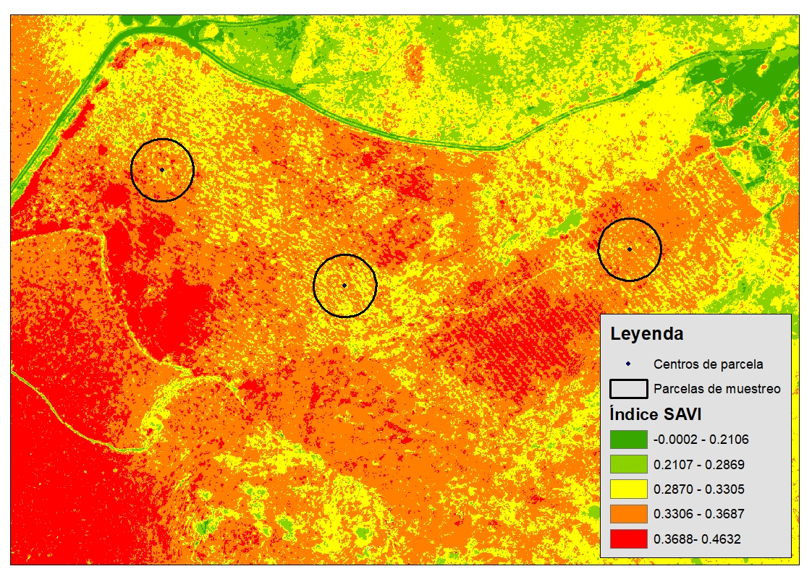
METHODOLOGY
(
2. Image analysis
NIR
RED
GREEN
RED EDGE
RED
GREEN
BLUE
RED EDGE
RED
BLUE
13 vegetation indexes (NDVI, REGCI, NLI, SAVI…)
Example of vegetation index map calculation
SAVI (Soil Adjusted Vegetation Index)
Notes:
Eucaliptus globulus young stands coming from PLANTATIONS (4-6 years old)
Continous stands, at least 5 ha
To install the plots in two areas with different degree of attack (Strong and weak)
Differences in orography to install the plots along the study area (high, low and middle slope)

Slide 10
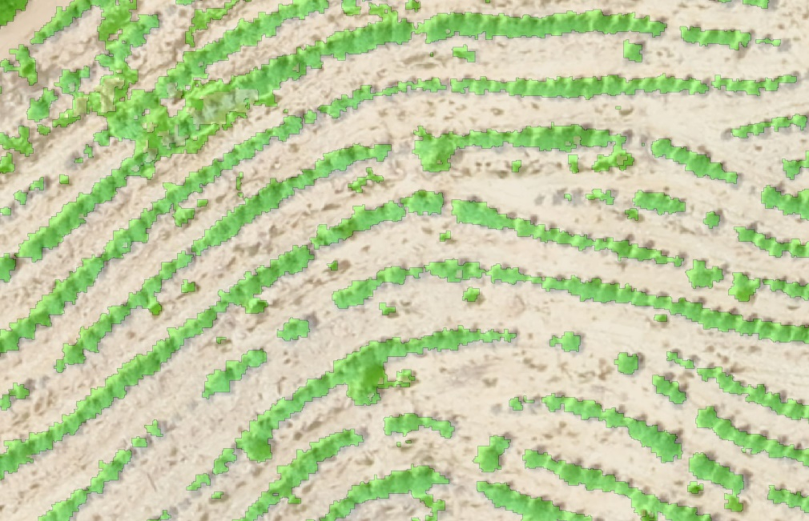
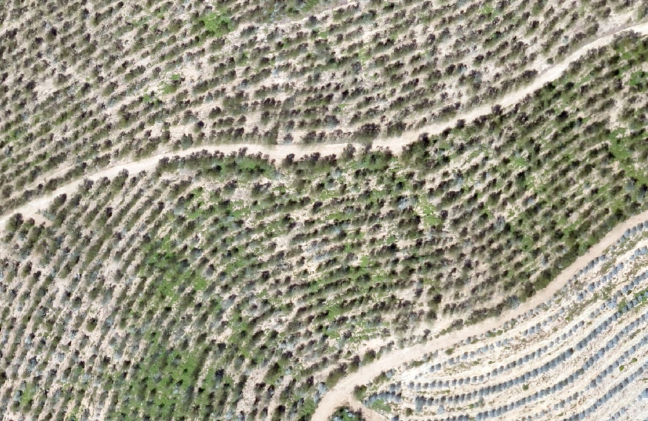
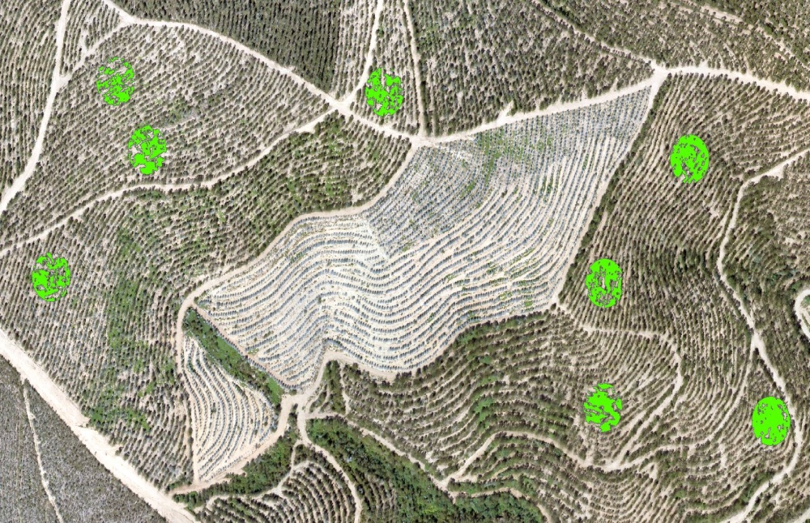
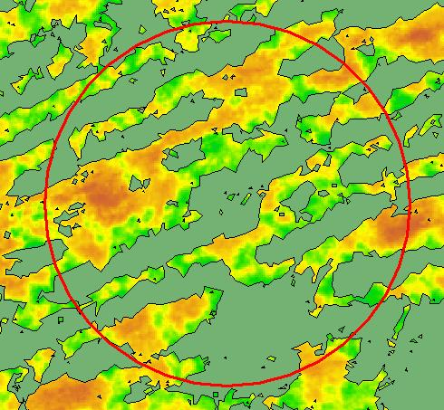
METHODOLOGY
(
3. Field data + index maps
Creation of a “vegetation mask” to remove soil effect in the indexes values
PLOT | NDVI | GNDVI | RENDVI | SAVI | DEF
1 | 0.61 | 0.66 | 0.21 | 0.35 | 5
2 | 0.61 | 0.65 | 0.21 | 0.34 | 6
3 | 0.58 | 0.63 | 0.20 | 0.35 | 7
4 | 0.69 | 0.71 | 0.24 | 0.38 | 7
5 | 0.71 | 0.71 | 0.24 | 0.39 | 6.5
6 | 0.66 | 0.68 | 0.23 | 0.36 | 3
4. Statistical analysis
Correlation between:
Indexes average values
Defoliation level
Average index value in each plot is calculated as the average values of all the vegetation pixels
Notes:
Necesidad del desarrollo o implementación de metodologías/herramientas para la sostenibilidad económica y ambiental del uso de la biomasa forestal
Herramientas de análisis espacial de disponibilidad de biomasa.
Optimización aprovechamiento
Logística de transporte

Slide 11
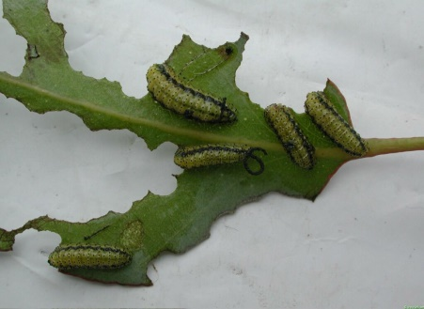
RESULTS
(
1. Damage inventory
Percentage of trees within each defoliation level per study area
Defoliation | Asturias | Cantabria | Galicia | Portugal
1 | 9.1 | 12.6 | 51.6 | 7.5
2 | 63.4 | 82.2 | 11.6 | 13.4
3 | 20.6 | 5.2 | 5.3 | 8.0
4 | 3.5 | 0 | 4.2 | 8.6
5 | 1.5 | 0 | 9.5 | 13.4
6 | 0.9 | 0 | 13.7 | 31.1
7 | 0.3 | 0 | 4.2 | 17.1
LOW DAMAGE
HIGH DAMAGE
SPAIN (Asturias, Cantabria and Galicia) : 87 % of the trees are within defoliation levels 1, 2 and 3
PORTUGAL: 62.6% of the trees are in the highest categories of defoliation
Notes:
Necesidad del desarrollo o implementación de metodologías/herramientas para la sostenibilidad económica y ambiental del uso de la biomasa forestal
Herramientas de análisis espacial de disponibilidad de biomasa.
Optimización aprovechamiento
Logística de transporte

Slide 12
RESULTS
2. Correlation Analysis (Index-Defoliation)
VEGETATION INDEX | CORRELATION
NDVI | -0.178(**)
GNDVI | -0.154(**)
IPVI | -0.241(**)
GCI | -0.189(**)
NLI | -0.221(**)
NGRDI | -0.091(**)
NDRE | -0.344(**)
REGCI | -0.302(**)
RENDVI | -0.057(*)
SAVI | -0.119(**)
REGNDVI | -0.197(**)
ARI | -0.147(**)
ARI2 | -0.206(**)
NAME | FORMULA
NDRE (Normalized Difference Red Edge)
Red edge Chlorophyll Index (REGCI)
Indexes combining RED EDGE and NIR bands has the highest correlation with defoliation
Correlation between indexes average values and defoliation levels is low
**Significant correlation at level 0.01 (bilateral).
Notes:
Los índices calculados con las cámaras modificadas presentan un bajo grado de correlación con la defoliación y las diferencias entre grupos no son significativas.
En el caso del Sensor Sequoia los índices que presentan un grado de correlación más alto con la defoliación y que presentan diferencias significativas, contienen la banda verde, muy relacionada con el contenido de clorofila
Los NGRDI no son útiles para la obtención de mapeo de vigorosidad de cultivos.
Para obtener datos de vigorosidad vegetativa, es fundamental trabajar con el infrarrojo cercano, no aportando excesiva información el trabajar solo con la banda roja o verde. Las combinaciones de la banda del rojo y la del verde entre si no aportan ningún tipo de información que nos sirva para determinar el estado vegetativo de los cultivos (NGRDI)

Slide 13
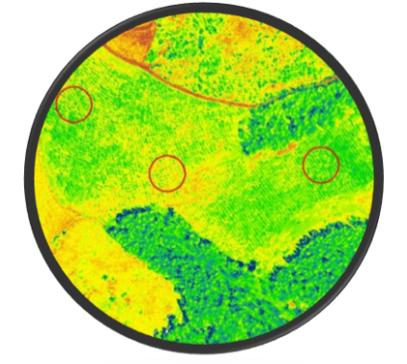
CASE STUDY
How can this results be improved?
3. Working at individual tree level
From the central coordinates of each tree, a buffer of 0.5 is drawn to delimitate the crown
AVERAGE VALUE OF THE INDEX IS CALCULATED FOR EACH TREE AS THE AVERAGE OF ALL THE PIXEL VALUES WTHIN THE CROWN
4. Statistical analysis
Principal components analysis (PCA):
Indexes average values
Defoliation level
ID Tree | Defoliation | NDVI | RENDVI | SAVI
1 | 2 | 0.58 | 0.09 | 0.23
2 | 2 | 0.52 | 0.08 | 0.36
3 | 1 | 0.59 | 0.16 | 0.47
Notes:
In this study the front two principal component (PCI) spectra were derived from the canopy hyperspectral reflectance, which could explain over 98% of information variation
Due to high similarity among individual bands of a multispectral image, statistical data compression tools like principal component analysis (PCA) are often applied in image analysis and image classification to reduce the amount of redundant information
Principal Component Analysis (PCA) which is a technique
for removing or reducing the duplication or redundancy in
multispectral images and for compressing all of the
information that is contained in an original n-channel set
of multispectral images into less than n channels or, more
specifically, to their principal components (Ricotta et al.,
1999)

Slide 14
CASE STUDY
(
GLOBAL PCA ANALYSIS . COMPONENTS MATRIX (1 & 2&3)
Correlation between all index maps and Principal Components
 | Eigenvalues
Component | Total | % Variance | % Accumulated
1 | 9.851 | 70.367 | 70.367
2 | 1.801 | 12.867 | 83.234
3 | 1.109 | 7.920 | 91.155
In this study , 91 % of the spectral information was collected on the first 3 principal components (PCI) derived from the vegetation indexes
Further steps
Creation of an “Hibrid index” using the PC which were highly loaded with the spectral information of defoliation
Notes:
Algunas notas. principal component analysis (PCA) has been extensively studied as a data compression technique
SAVI. Empirically derived NVDI products have been shown to be unstable, varying with soil colour, soil moisture, and saturation effects from high density vegetation.
ARI allowed an accurate estimation of anthocyanin accumulation (STD within 3.9 nmol/cm2), even in minute amounts, in intact stressed and senescing leaves
Los NGRDI no son útiles para la obtención de mapeo de vigorosidad de cultivos.
Para obtener datos de vigorosidad vegetativa, es fundamental trabajar con el infrarrojo cercano, no aportando excesiva información el trabajar solo con la banda roja o verde. Las combinaciones de la banda del rojo y la del verde entre si no aportan ningún tipo de información que nos sirva para determinar el estado vegetativo de los cultivos (NGRDI)
The results obtained from this study show that Principal Components of raw bands and vegetation indices can extract valuable and concentrated vegetation information by creating a new variable set with eliminated interband correlation and reduced dimensionality of the data. In this method Principal Components which were highly loaded with the spectral information of desired band or index considered as a feature component, and used in the classification process. By using this method the accuracy of classification could be increased up to 12%.
Hola Cova
va la diapo que faltaba de la parte de PCA. Es un analísis con todos los datos de árbol individual (incluye todas las parcelas y todos los vuelos). El enfoque se ha usado en agricultura varias veces.... He seleccionado algunos trabajos similares para que veas el planteamiento y discusión de resultados. Lo importante es que estos valores se incrementan bastante con el nivel de daños. A expensas de tener datos con más daños para poder hacer un PCA comparativo, se puede explicar que variables (indices) aportan ruido al análisis multivariante y cuales tienen menos interés. He puesto unas notas en el pie y las conclusiones que se pueden plantear sin problemas. Con todos los datos habría que repetir y luego el procedimiento sería ir eliminado las variables que aportan menos para quedarse con al menos dos ejes (te he dejado dos porque es más fácil de explicar marcando los índices de mayor aporte) y los índices que se utilizarían para construir una herramienta que extraiga más varianza
abraços

Slide 15
CASE STUDY
(
PCA ANALYSIS BY INDEX . COMPONENTS MATRIX (1 & 2)
Correlation between input index maps and Principal Components
 | 1 | 2
NDVI | 0.979 | 0.124
GNDVI | 0.969 | 0.178
IPVI | 0.979 | 0.124
GCI | 0.947 | 0.160
NLI | 0.929 | 0.142
ARI2 | 0.957 | 0.060
REGNDVI | 0.818 | 0.182
NDRE | 0.774 | 0.508
ARI | 0.765 | 0.,312
REGCI | 0.787 | 0.514
RENDVI | 0.725 | 0.634
SAVI | 0.453 | 0.557
NGRDI | 0.270 | 0.391
Very high correlations with PC1
Contain NIR band
Razonably high correlations with PC1 and PC2
Contain RE band
Do not contain either the NIR or the RE band
Low correlation in PC1 and PC2
Notes:
Principal components of the 13 indexes were calculated and the list of image eigenvalues loadings for this transformation on all vegetation indexes are given in table 2
According to this table, correlations of PC1 with the indexes are very high the ones containing NIR band, and razonably high in the ones containing the RE band. However in the case of SAVI and NGRDI their low correlation
Algunas notas. principal component analysis (PCA) has been extensively studied as a data compression technique
SAVI. Empirically derived NVDI products have been shown to be unstable, varying with soil colour, soil moisture, and saturation effects from high density vegetation.
ARI allowed an accurate estimation of anthocyanin accumulation (STD within 3.9 nmol/cm2), even in minute amounts, in intact stressed and senescing leaves
Los NGRDI no son útiles para la obtención de mapeo de vigorosidad de cultivos.
Para obtener datos de vigorosidad vegetativa, es fundamental trabajar con el infrarrojo cercano, no aportando excesiva información el trabajar solo con la banda roja o verde. Las combinaciones de la banda del rojo y la del verde entre si no aportan ningún tipo de información que nos sirva para determinar el estado vegetativo de los cultivos (NGRDI)
The results obtained from this study show that Principal Components of raw bands and vegetation indices can extract valuable and concentrated vegetation information by creating a new variable set with eliminated interband correlation and reduced dimensionality of the data. In this method Principal Components which were highly loaded with the spectral information of desired band or index considered as a feature component, and used in the classification process. By using this method the accuracy of classification could be increased up to 12%.
Hola Cova
va la diapo que faltaba de la parte de PCA. Es un analísis con todos los datos de árbol individual (incluye todas las parcelas y todos los vuelos). El enfoque se ha usado en agricultura varias veces.... He seleccionado algunos trabajos similares para que veas el planteamiento y discusión de resultados. Lo importante es que estos valores se incrementan bastante con el nivel de daños. A expensas de tener datos con más daños para poder hacer un PCA comparativo, se puede explicar que variables (indices) aportan ruido al análisis multivariante y cuales tienen menos interés. He puesto unas notas en el pie y las conclusiones que se pueden plantear sin problemas. Con todos los datos habría que repetir y luego el procedimiento sería ir eliminado las variables que aportan menos para quedarse con al menos dos ejes (te he dejado dos porque es más fácil de explicar marcando los índices de mayor aporte) y los índices que se utilizarían para construir una herramienta que extraiga más varianza
abraços

Slide 16
CONCLUSIONS
(
The images acquired by multispectral cameras mounted on a UAV have proved to be a promising tool for the evaluation of defoliation caused by Gonipterus platensis.
In areas where the attack of the insect is weak, vegetation indexes showed low sensitivity to defoliation.
In this study, 91 % of the spectral information was collected on the first 3 principal components (PCI) derived from the vegetation indexes
In the next step, Principal Components which were highly loaded with the spectral information of defoliation will be considered to create an “Improved index” specially designed for defoliation estimation.
Notes:
In areas where the insect attack is weak, the capacity of the vegetation indexes to explain the variability of the defoliation is low. However, in areas where the attack of the insect is strong, their sensitivity to defoliation changes increases considerably.

Slide 17
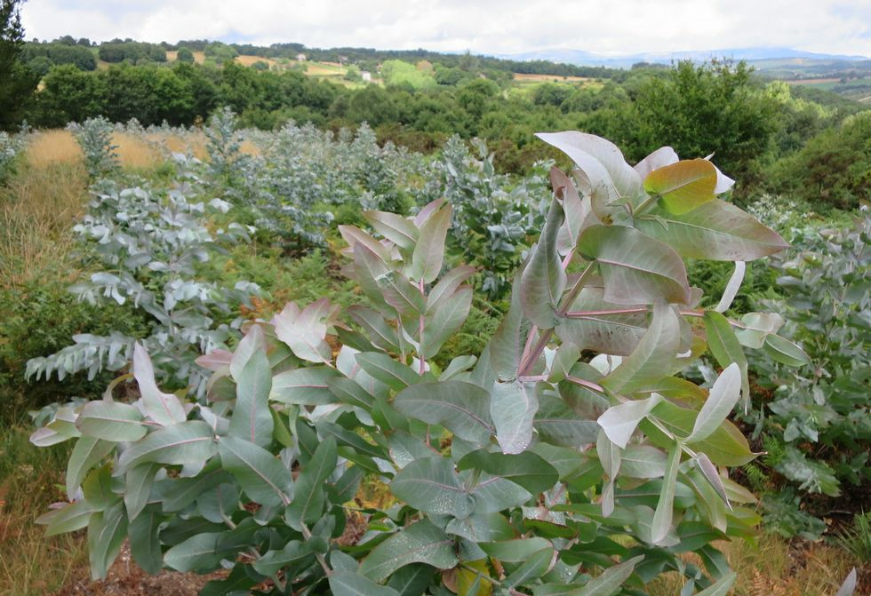
CONSECUENCES FOR EUCALYPTUS PLANTATIONS MANAGEMENT
(
Optimization of the methodologies of detection and monitoring of damages
Qualitative evaluation (subjective) Quantitative evaluation (objective)
Use these methodologies to calibrate and validate models for calculations of variables, such as LAI (Leaf Area Index)
Possibility of real-time integration of defoliation damages in models to evaluate the effect on productivity at plot scale os spatial scale.
Notes:
Optimization of the methodologies of detection and monitoring of damages (from qualitative evaluation - subjective - to quantitative evaluation).
Possibilty of real-time integration of defoliation damages in models to evaluate the effect on productivity at plot scale os spatial scale.

Slide 18
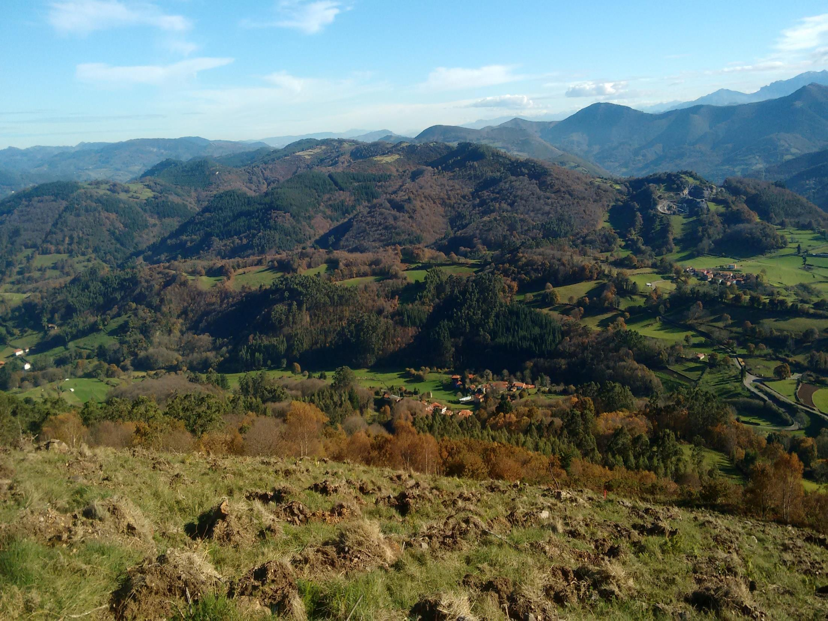
Thank you for your attention
Any questions?
Corresponding author: cprendes@cetemas.ess

